Slide 1












Title Screen
Console vs Video Game Sales
Jamison Unruh, Megan Zimerman, Ivan Pinedo, Karl Konzi, Rachidi Ndongala

Slide 2

Level 8 – Enemy 8
Data Sources
Data World
https://data.world/sumitrock/video-games-sales
Kaggle
https://www.kaggle.com/jaimepazlopes/game-console-manufactor-and-sales

Slide 3
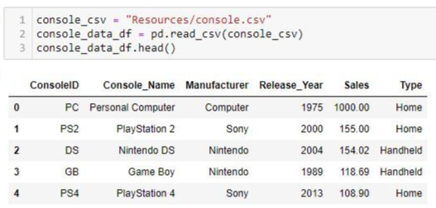
Level 8 – Enemy 8
Extract
Pulled the CSV files using python and read the files into a data frame.

Slide 4
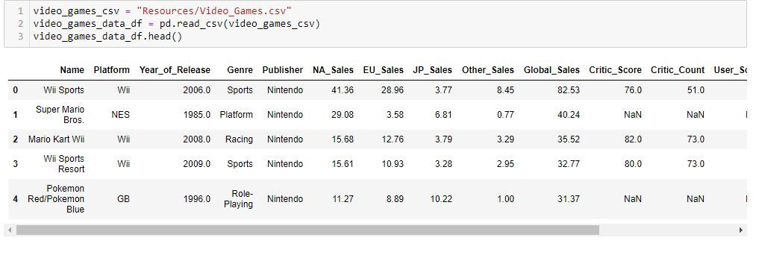
Level 8 – Enemy 8
Extract
Cleaned the data to drop the extra sales data in the video games data frame. We only pulled global sales numbers and renamed the column to “sales”

Slide 5

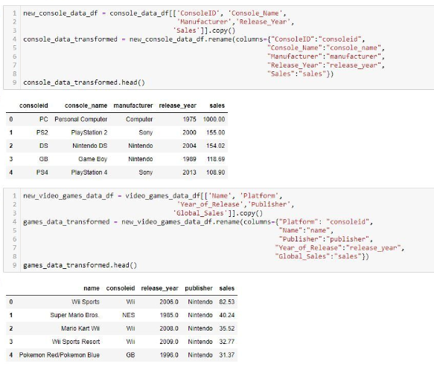






Level 6 – Enemy 4
Transform
Both lists have “console_id” as a common column to be able to be merged on in order to compare game sales vs console sales

Slide 6

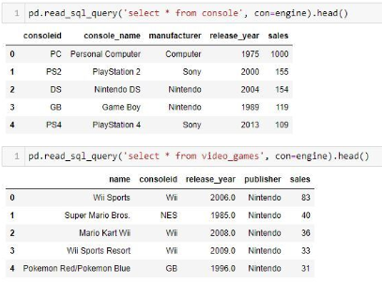

Level 3 – Enemy 1
Load

Slide 7



Level 14 - Boss
Questions?

Slide 8








Princess

